Slide 1

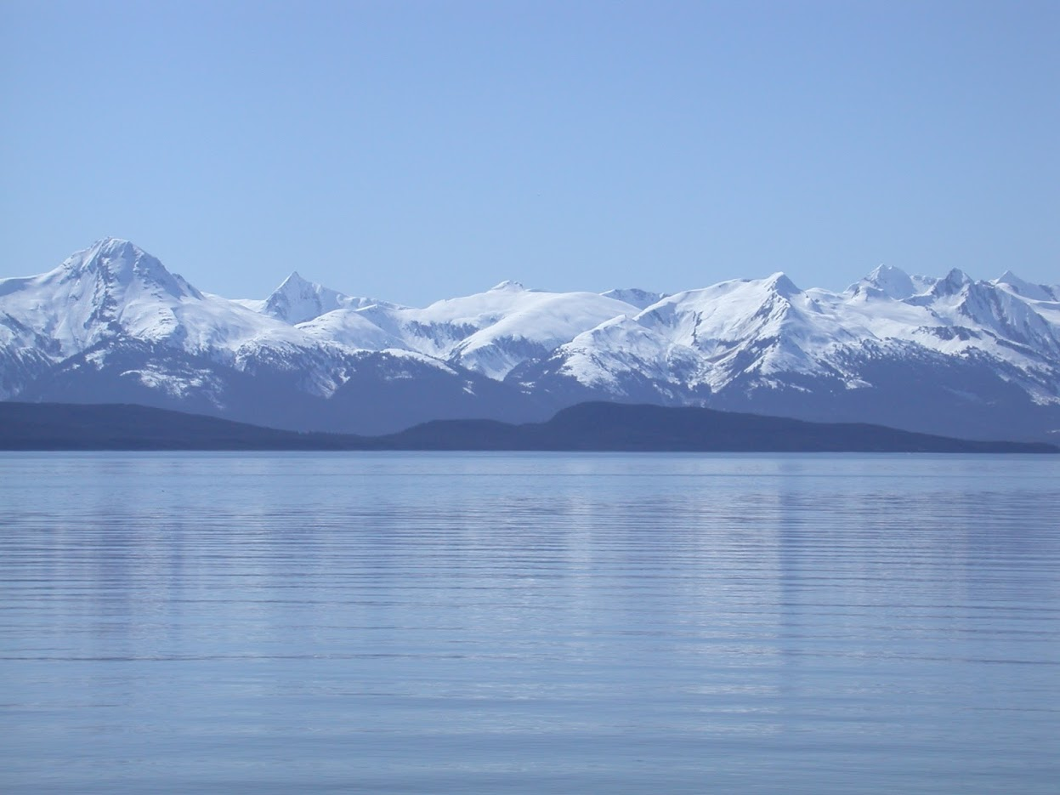

GOA Skate Stock Complex Update
Lee Cronin-Fine
November, 2023, Presentation to the GOA Groundfish Plan Team

Slide 2
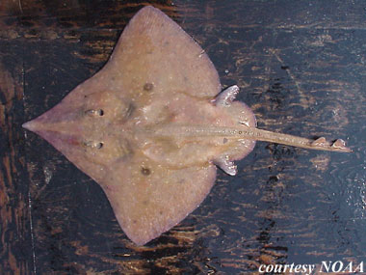
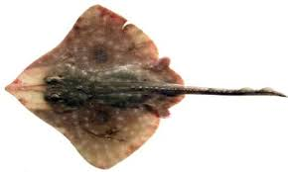
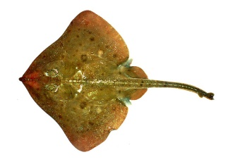
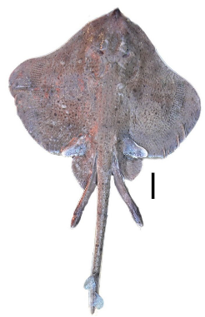
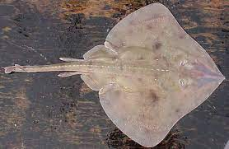
Assessment Groups
Longnose Skate
Big Skate
Other Skates
Notes:
Other Skate is made of 13 species all in the Bathyraja family. The most common are the Aleutian Skate, Alaska Skate and Bering skate

Slide 3
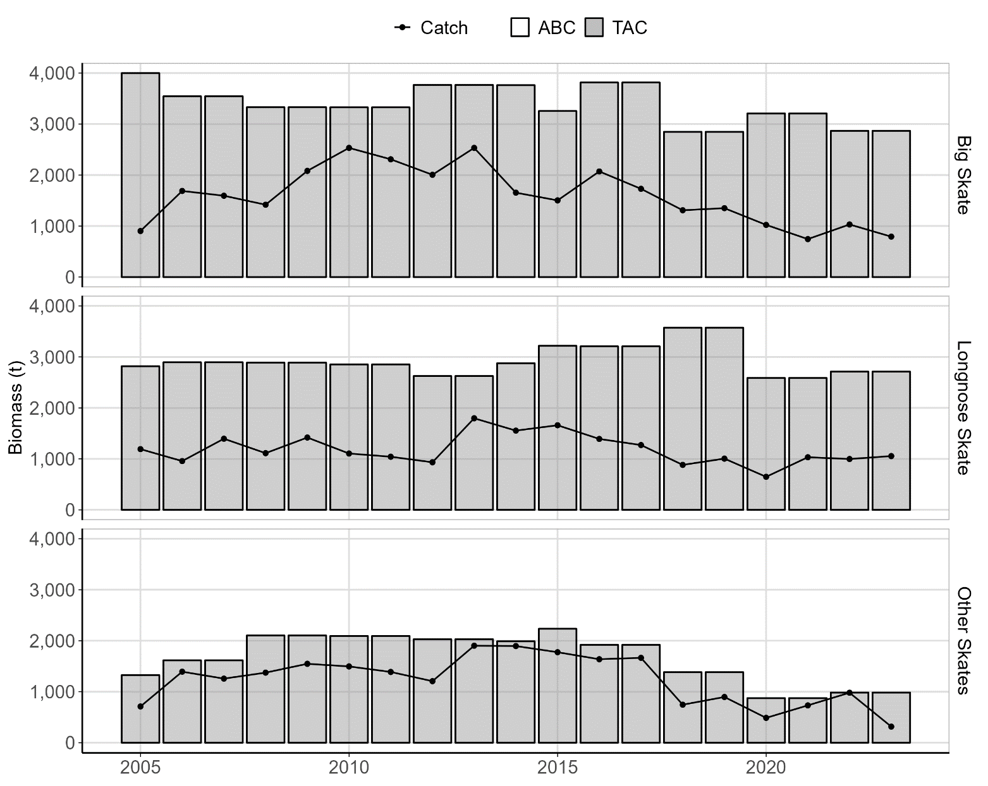
Stock Complex Overview
Tier 5
Group | OFL (t) | ABC (t) | Catch (t)*
Big | 3,822 | 2,867 | 792
Longnose | 3,616 | 2,712 | 1,055
Other | 1,311 | 984 | 316
*As of October 16th, 2023

Slide 4
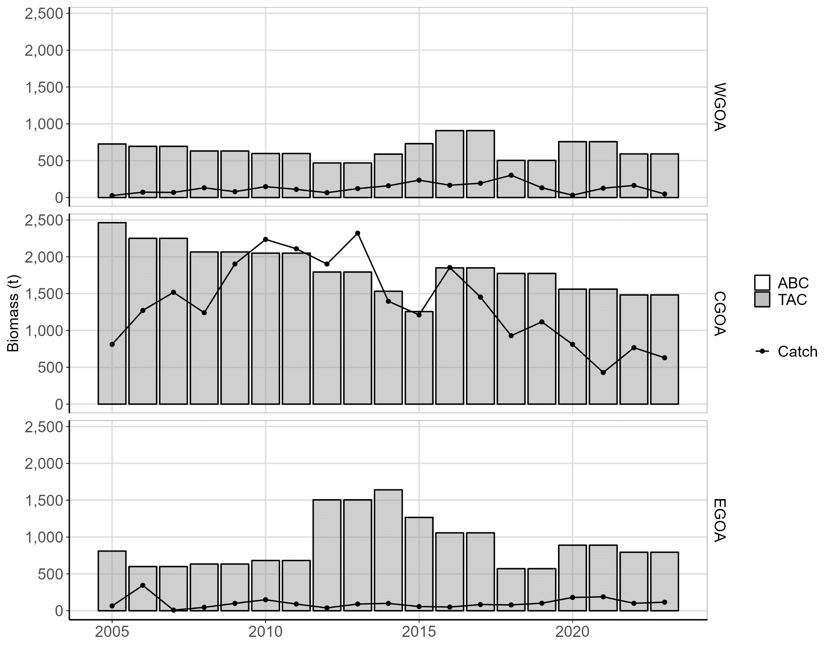
Big Skate Area Overview
Tier 5
Area | ABC (t) | TAC (t) | Catch (t)*
WGOA | 591 | 591 | 47
CGOA | 1,482 | 1,482 | 629
EGOA | 794 | 794 | 116
*As of October 16th, 2023

Slide 5
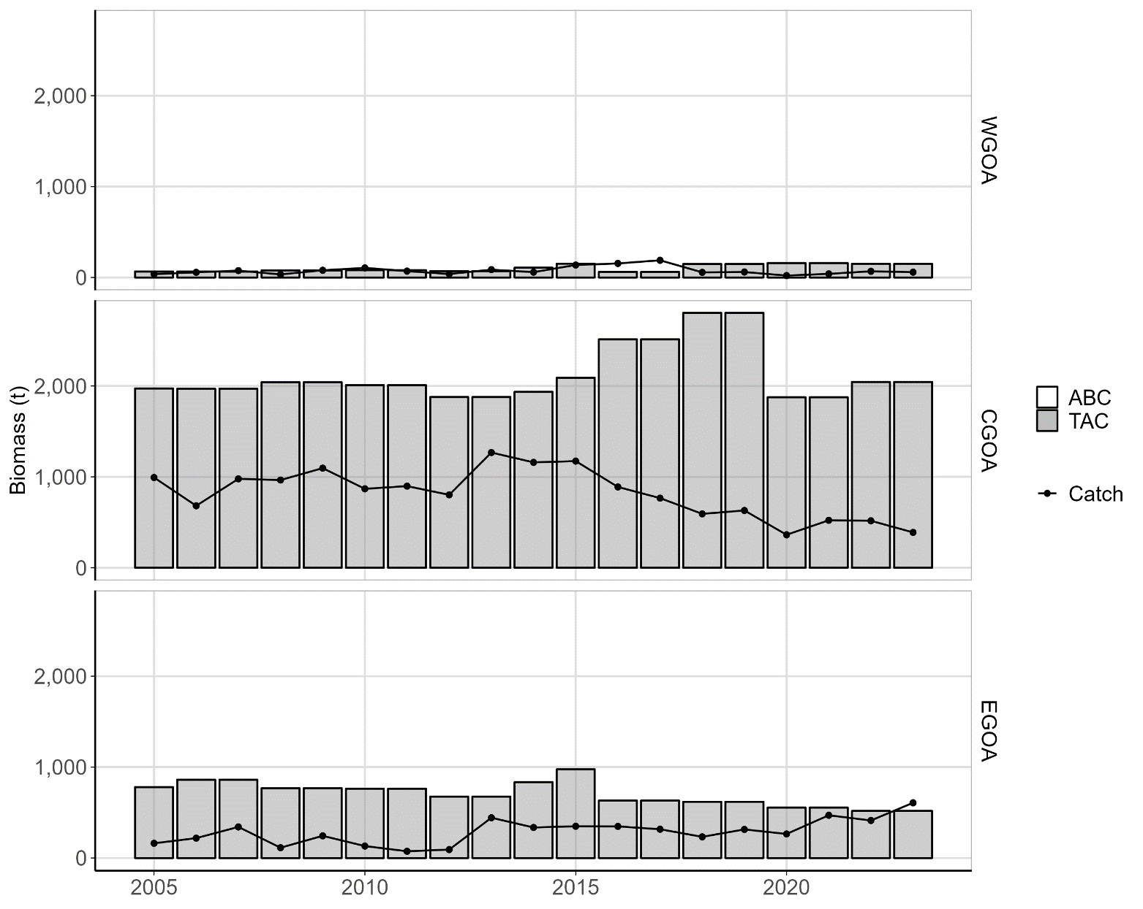
Longnose Skate Area Overview
Tier 5
Area | ABC (t) | TAC (t) | Catch (t)*
WGOA | 151 | 151 | 59
CGOA | 2,044 | 2,044 | 389
EGOA | 517 | 517 | 607
*As of October 16th, 2023

Slide 6
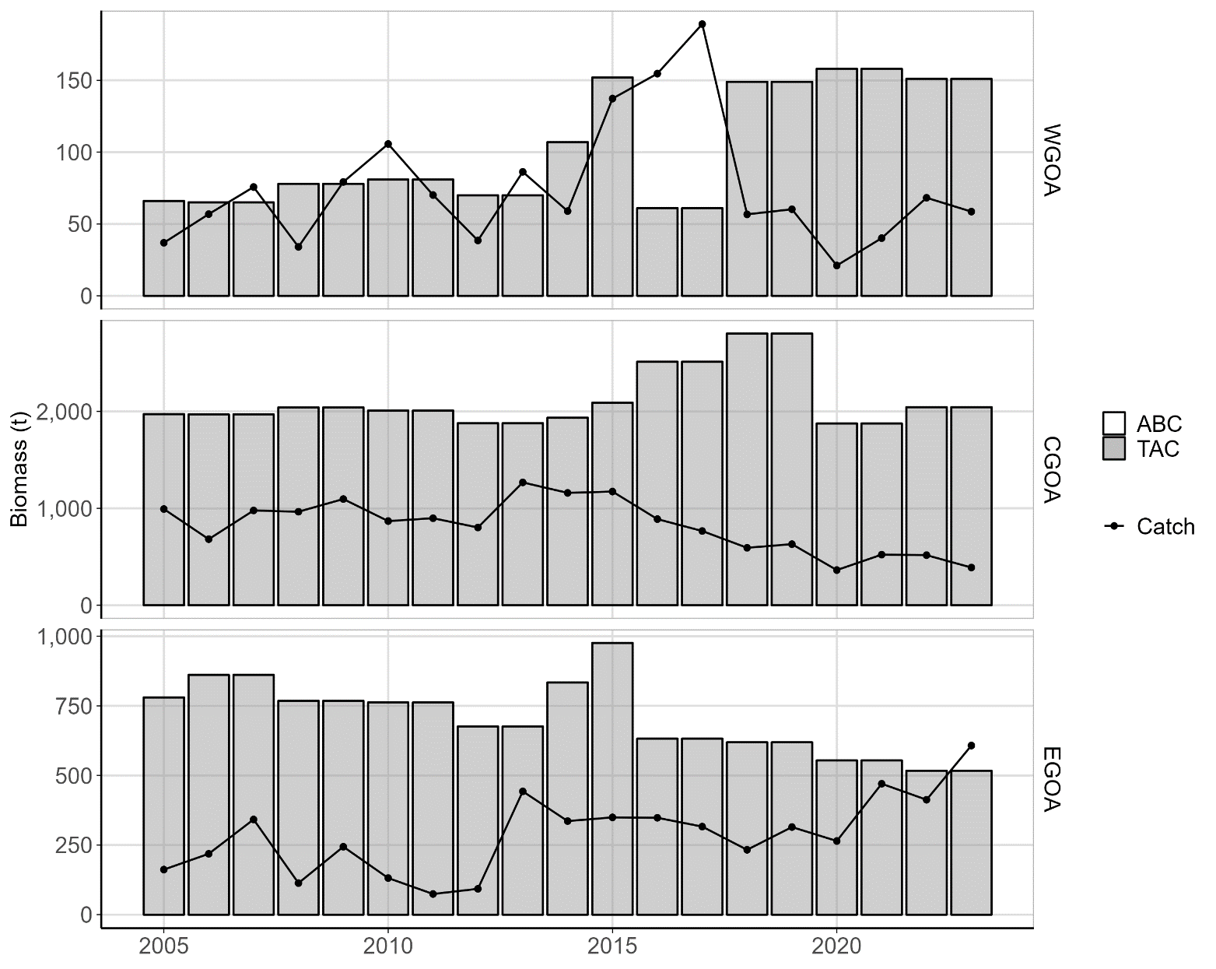
Longnose Skate Area Overview
Tier 5
Area | ABC (t) | TAC (t) | Catch (t)*
WGOA | 151 | 151 | 59
CGOA | 2,044 | 2,044 | 389
EGOA | 517 | 517 | 607
*As of October 16th, 2023

Slide 7
Longnose Skate Area Overview
Tier 5
Area | ABC (t) | TAC (t) | Catch (t)*
WGOA | 151 | 151 | 59
CGOA | 2,044 | 2,044 | 389
EGOA | 517 | 517 | 607
*As of October 16th, 2023

Slide 8
Analytical Approach
Update Assessment
Random Effects (RE) model
M = 0.1
Updated Data
Catch (2022-2023 as of October 16th)
Survey Biomass Estimate from AFSC bottom
trawl survey.
Notes:
- Switch from a random effects model developed by the Joint Plan Team Survey Averaging Working group to the REMA model. Was able to duplicate the results from the last assessment using the REMA model.
-Survey Biomass estimate is from the AFSC bottom trawl survey. There are two other surveys with relevant data, AFSC longline survey and IPHC longlins survey. The AFSC does not target bottom depths shallower than 150 m so it doesn’t sample Big skate well and only partially samples the other species. IPHC can be used as another source of information however this is an update and the previous skate assessment only used the AFSC bottom trawl survey when determining harvest recommendations. Including IPHC when determining the Harvest Recommendations in something that will be considered the next full assessment.

Slide 9
Analytical Approach
Other Skates
Single Gulf wide RE model

Slide 10
Analytical Approach
Big Skate
Longnose Skate
Single Gulf wide RE model
Other Skates
Two Models
Gulf wide RE model
Multivariate version of the
RE model (REM)
Notes:
- Multivariate version of the RM model allows for multiple strata/areas. This is used to determine proportion total biomass in each area. So to determine the total Big skate biomass in CGOA, you take the proportion produced by the REM model and multiply it by the total biomass produced by the RE model.

Slide 11
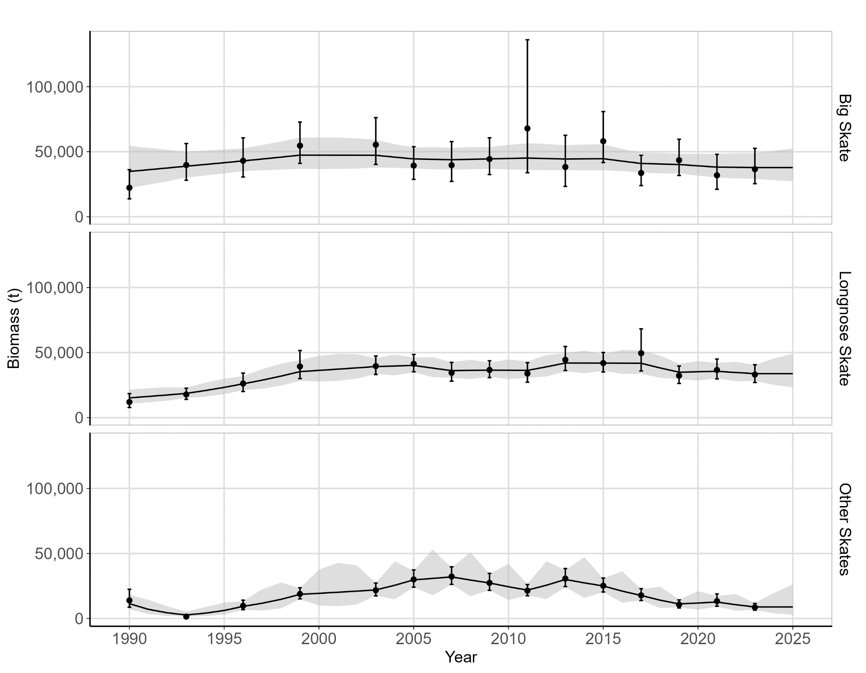
Gulf-wide RE model

Slide 12
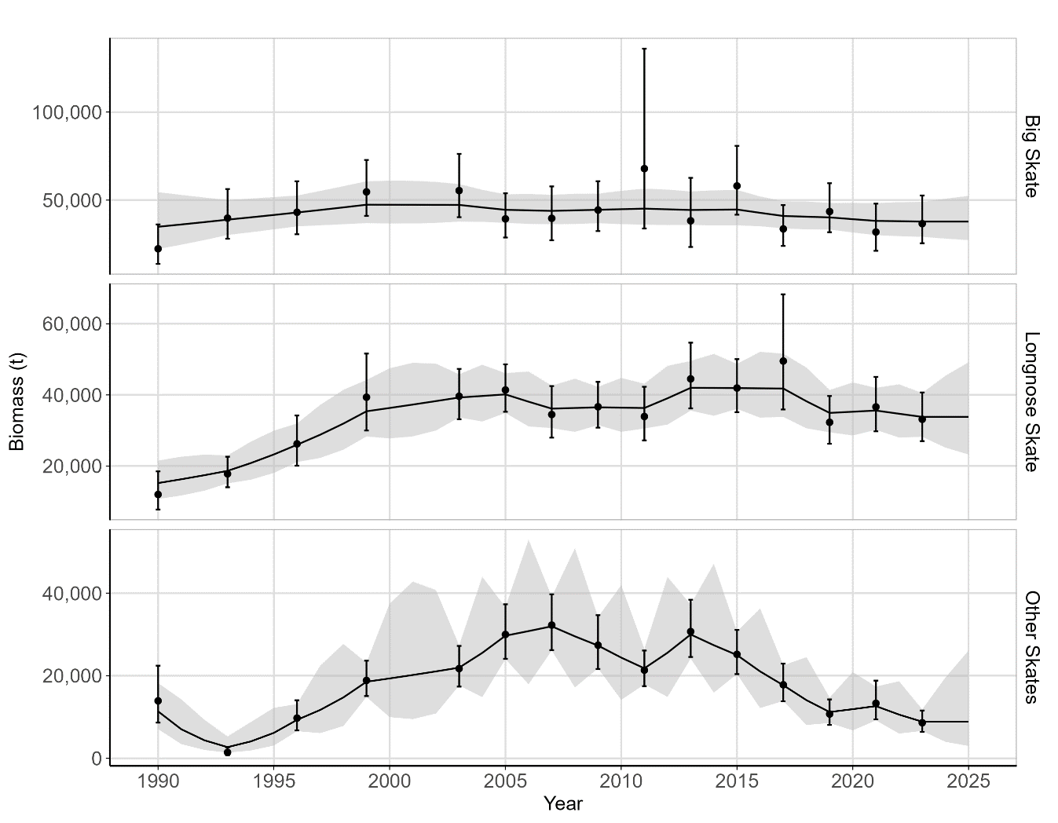
Gulf-wide RE model

Slide 13
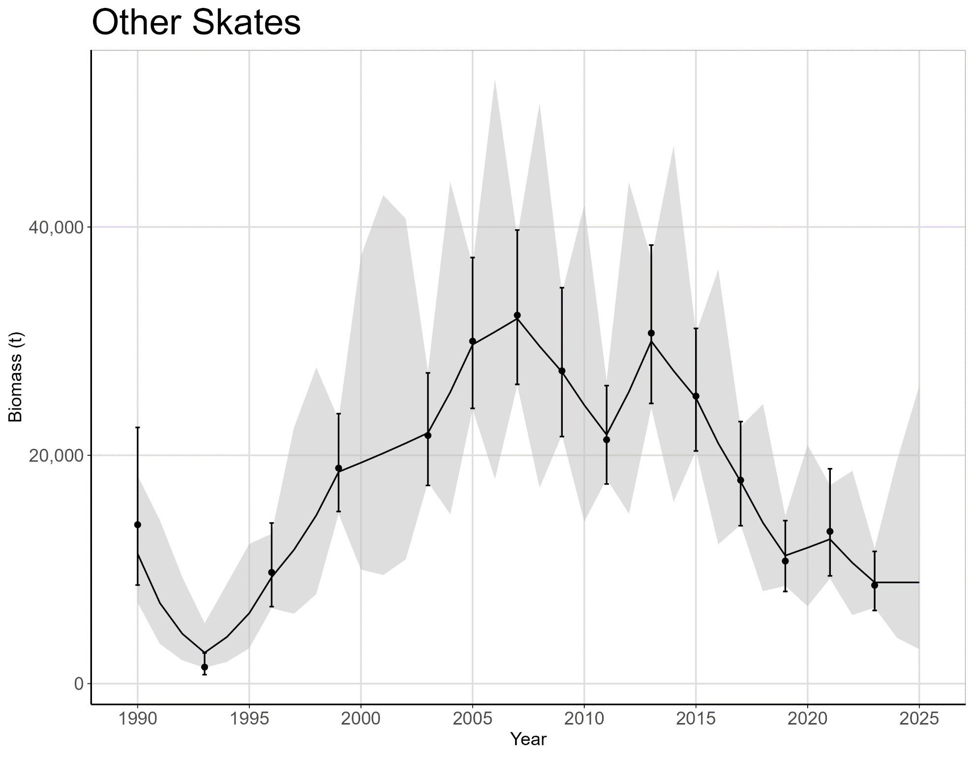
Gulf-wide RE model
2023 is the Lowest Estimated Biomass (8,869 t) since 1996
Notes:
Can’t tell if this decline is due to a decline in the population, or just annual variability. Just something that I wanted to point out. This estimate is from the RE model. The survey value is 8,617 t which is the lowest since 1993.

Slide 14
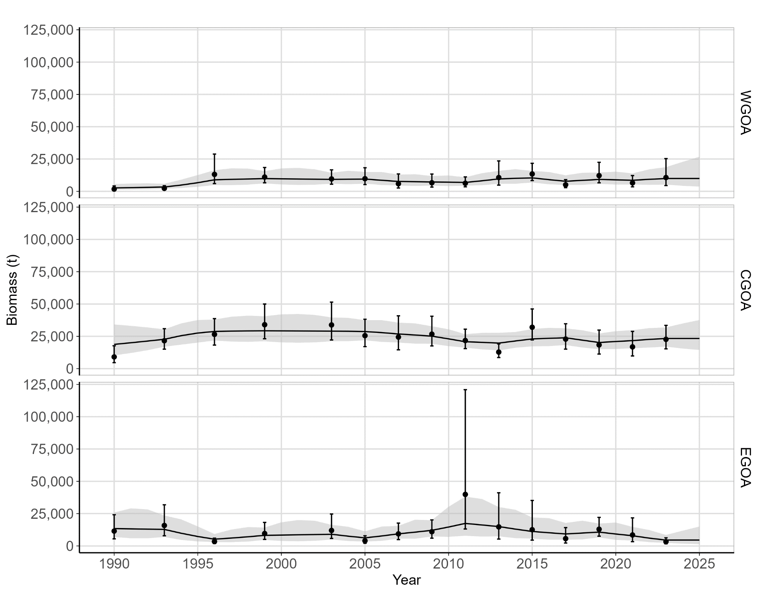
Big Skate Area REM

Slide 15
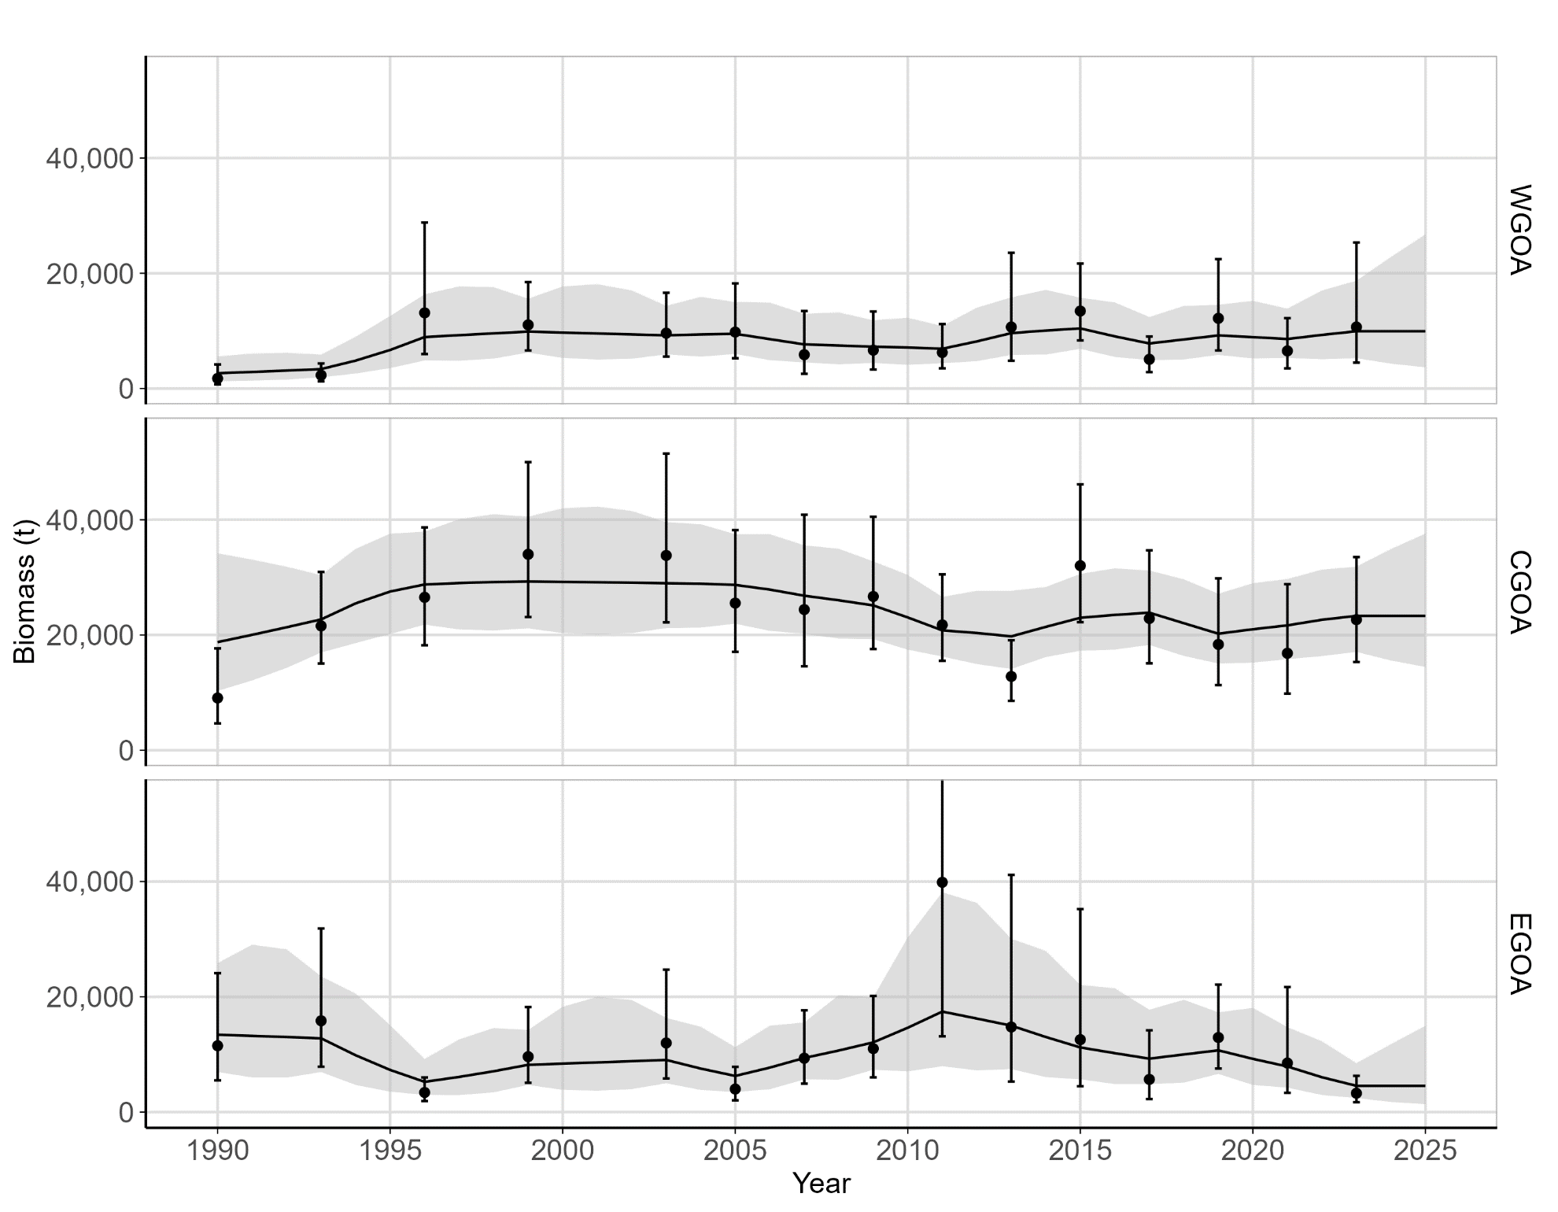
Big Skate Area REM

Slide 16
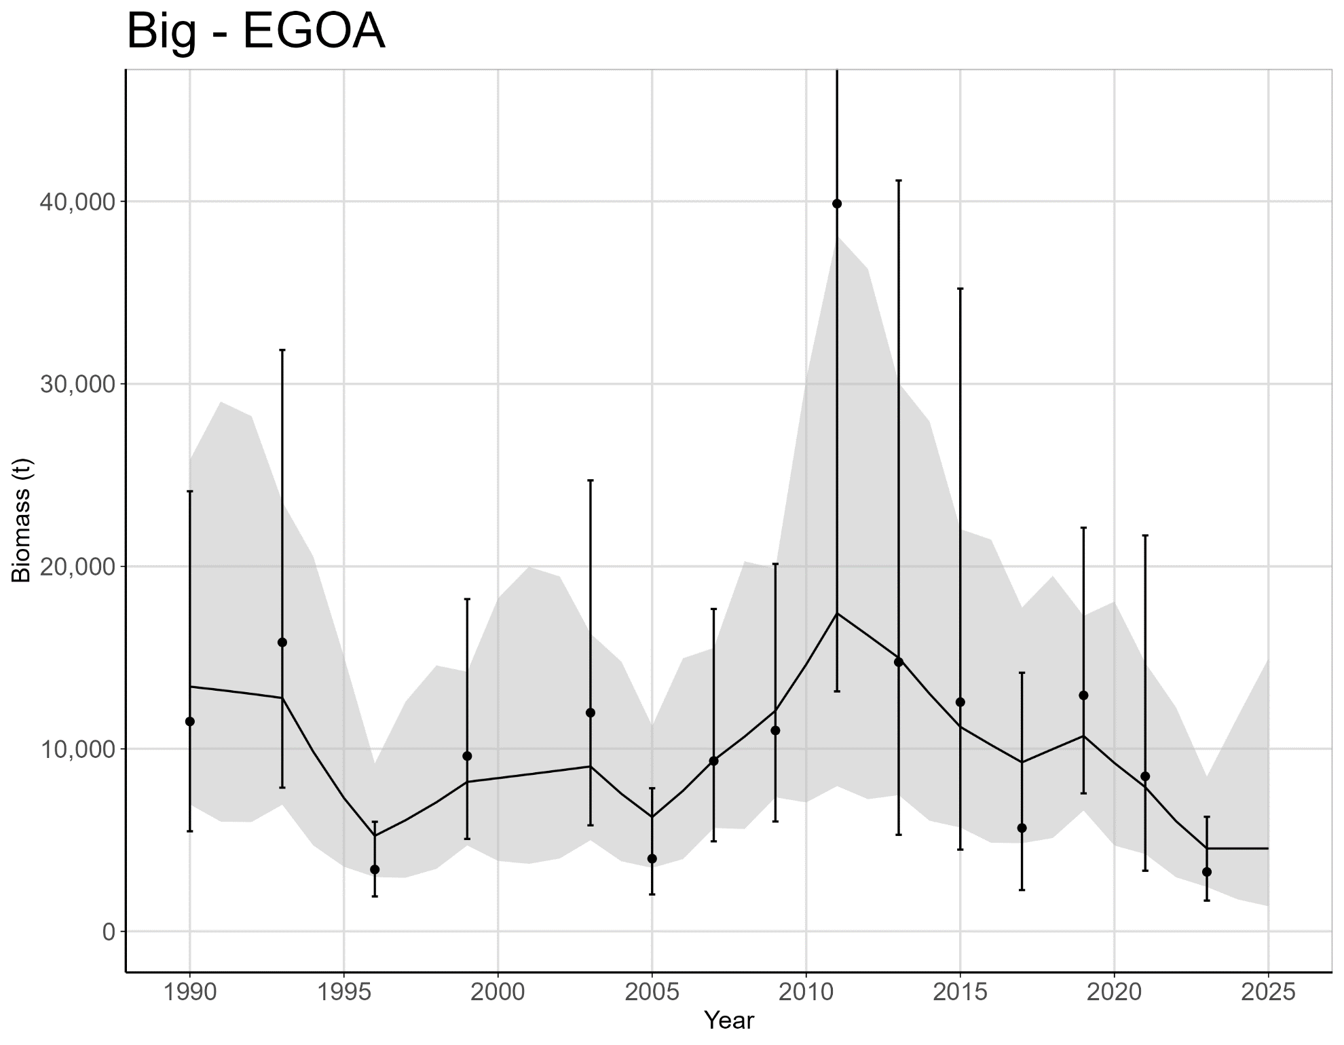
Big Skate Area REM
2023 is the Lowest Estimated Biomass (4,545 t)
Notes:
This estimate is from the RE model. The survey value is 3,258 t which is the lowest ever. The previous value was 8,495 t which is a 61% decline.

Slide 17
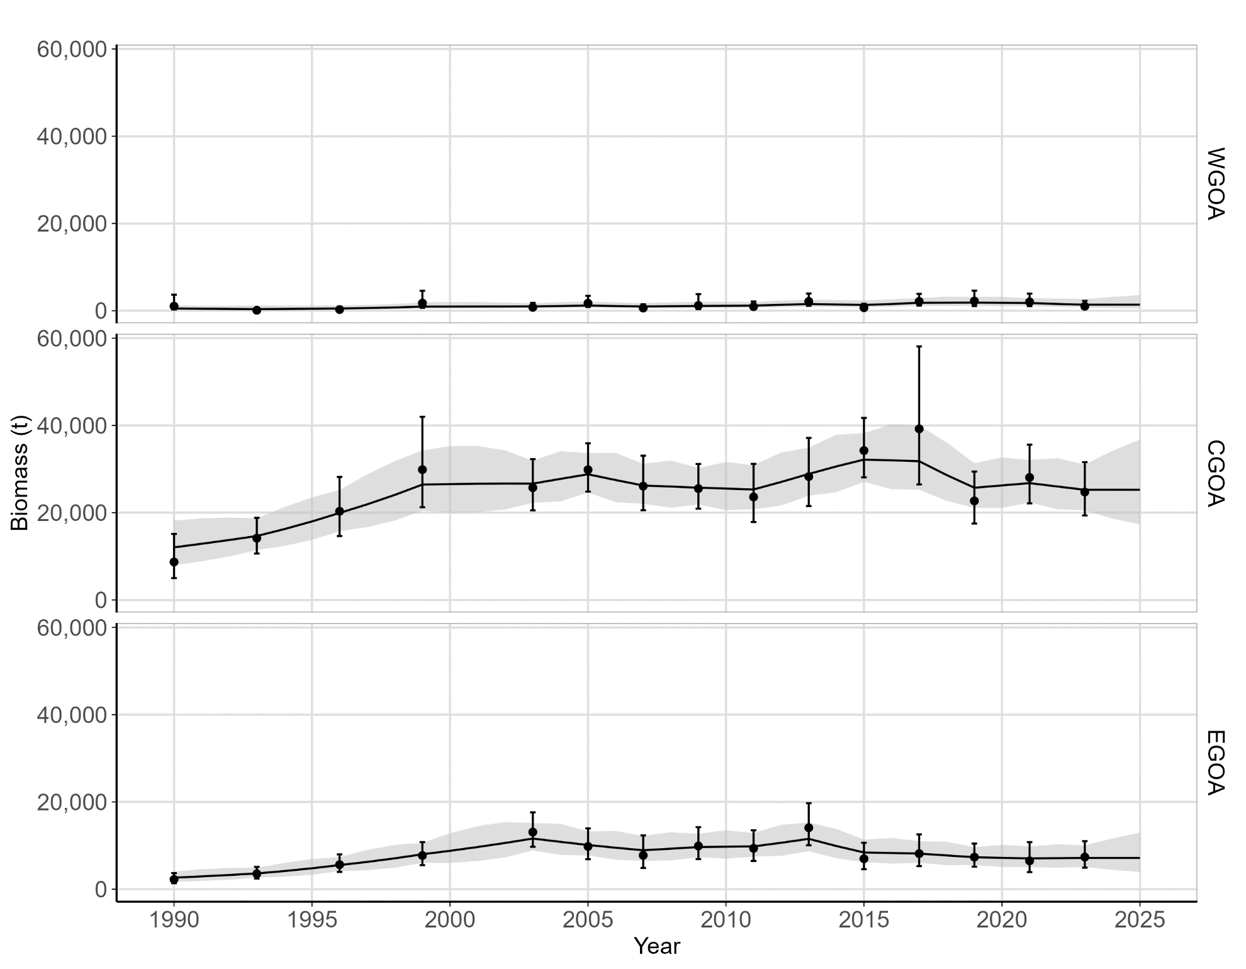
Longnose Skate Area REM
Notes:
Mention how the Catch is over the ABC in EGOA but the estimated biomass looks okay

Slide 18
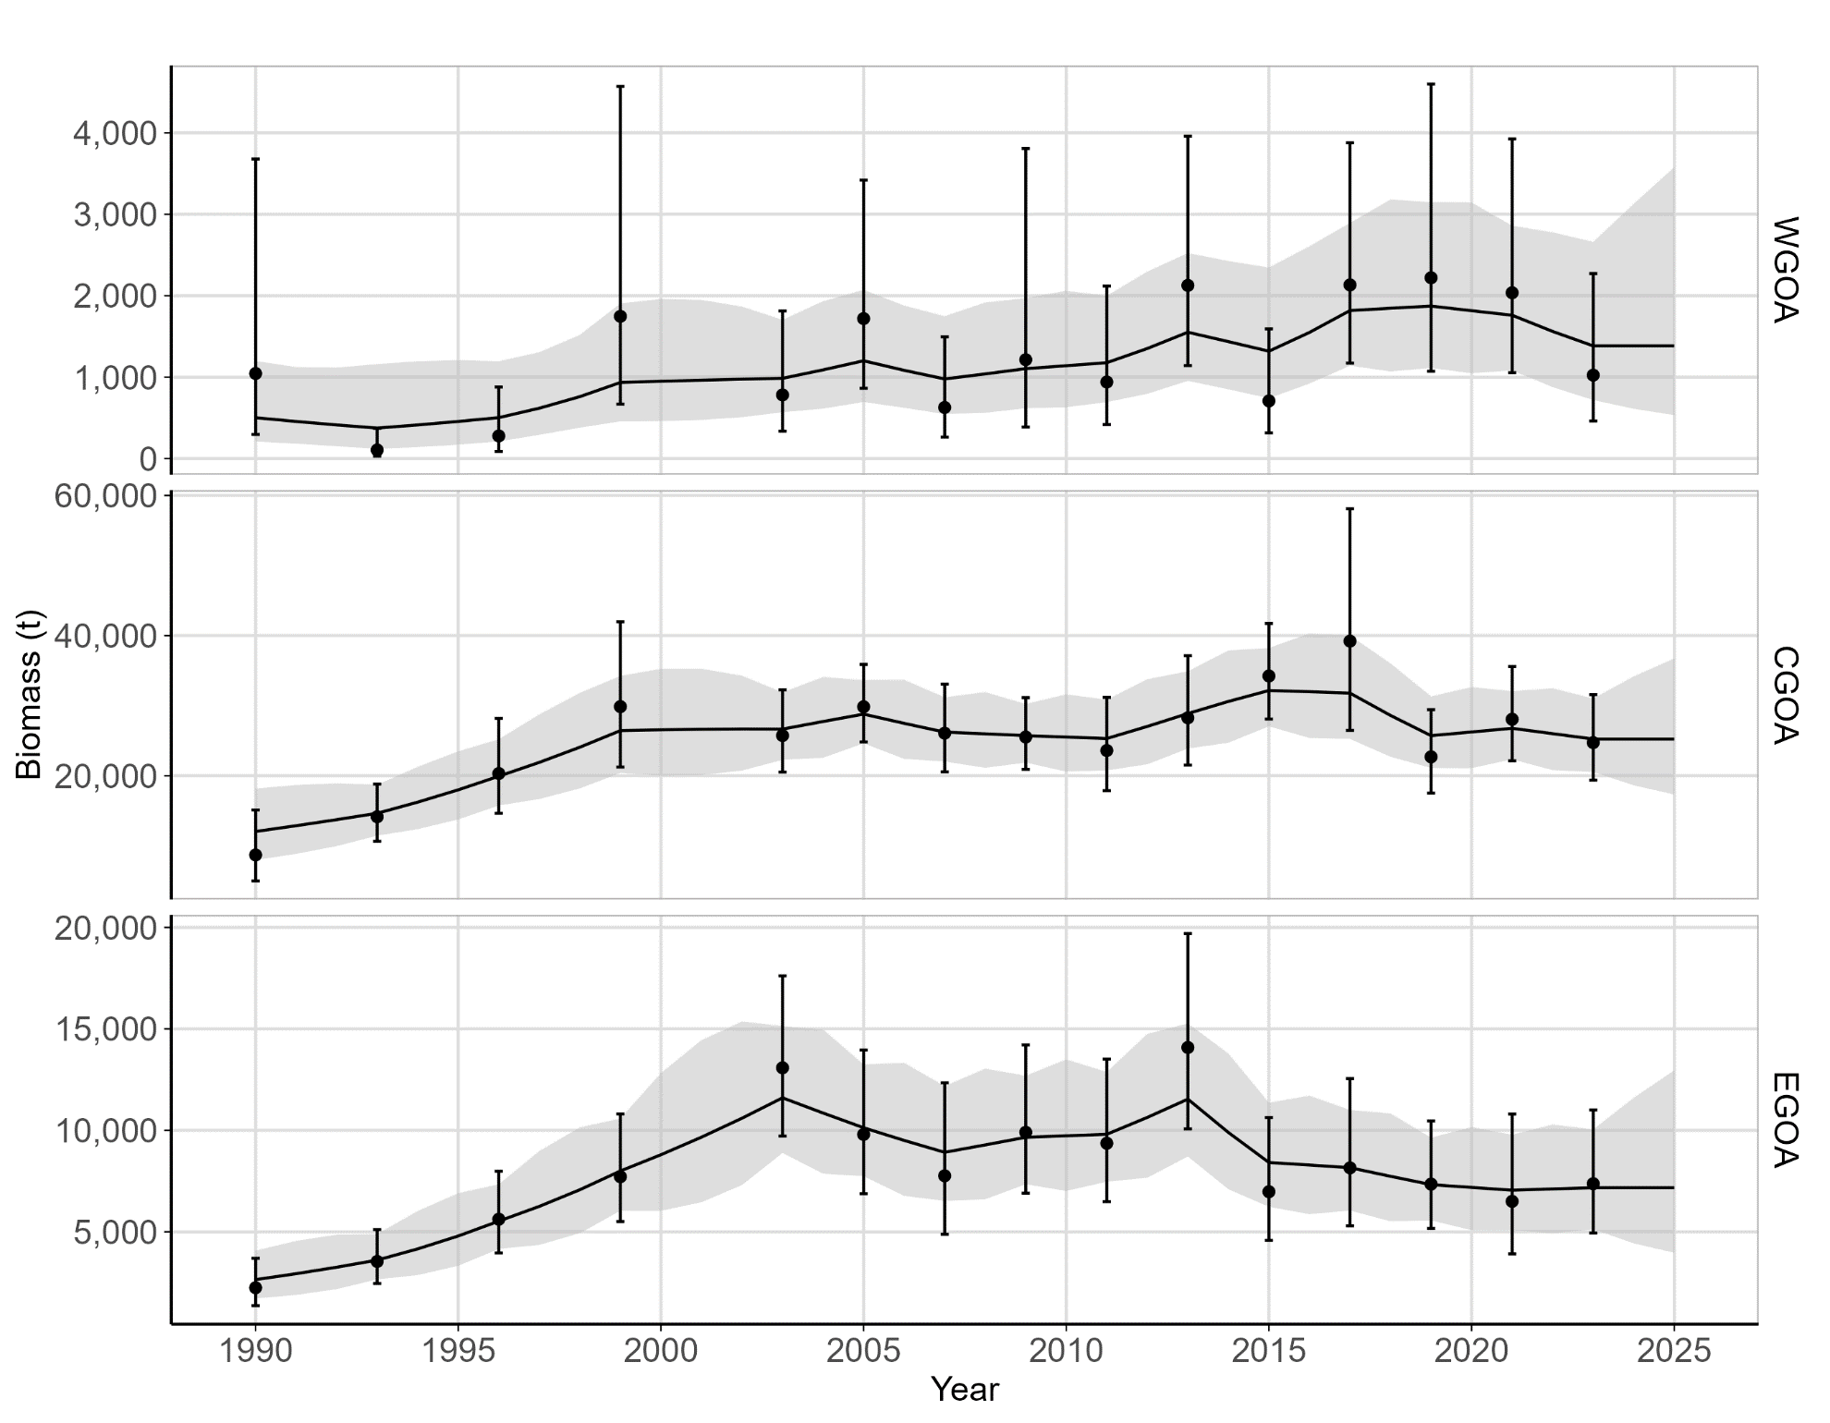
Longnose Skate Area REM
Notes:
Mention how the Catch is over the ABC in EGOA but the estimated biomass looks okay

Slide 19
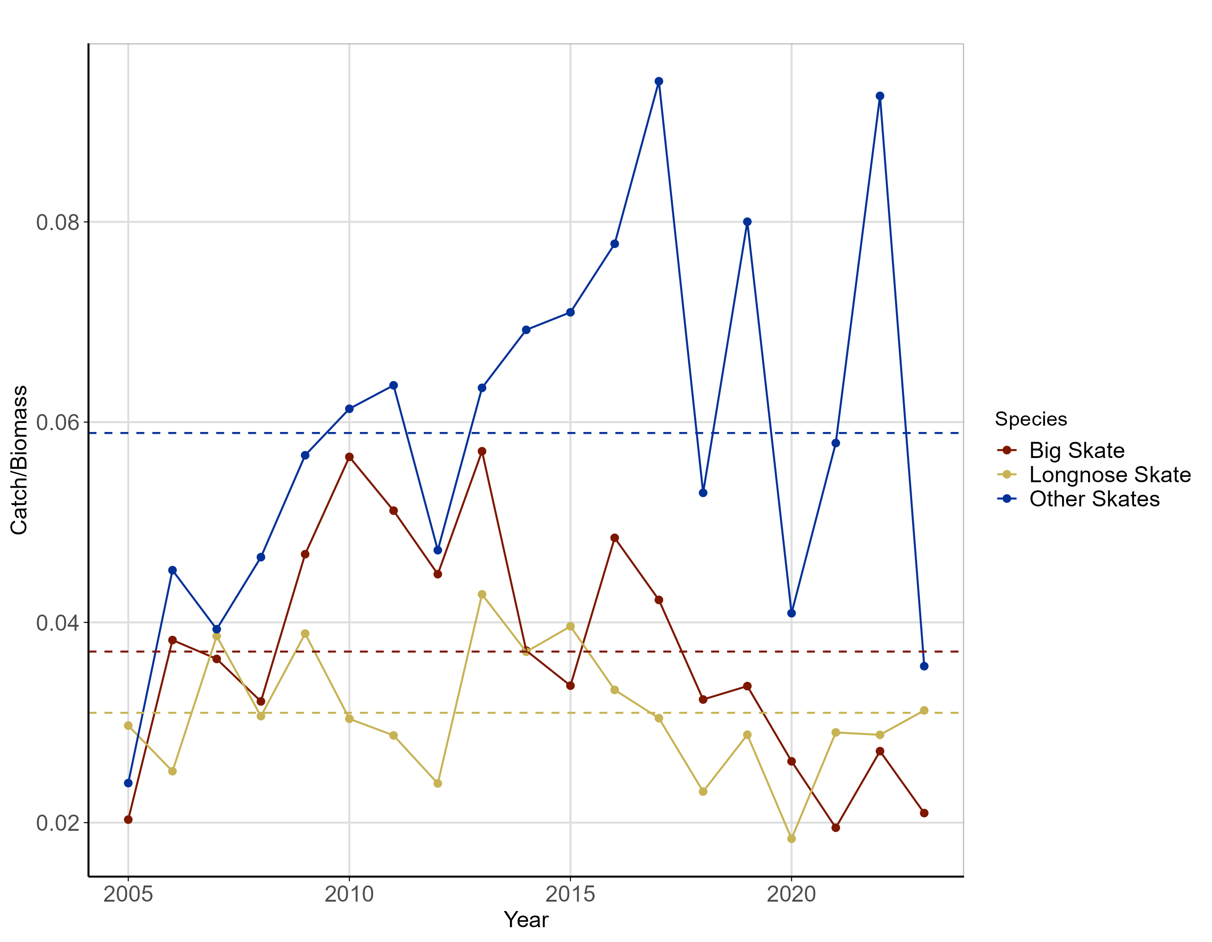
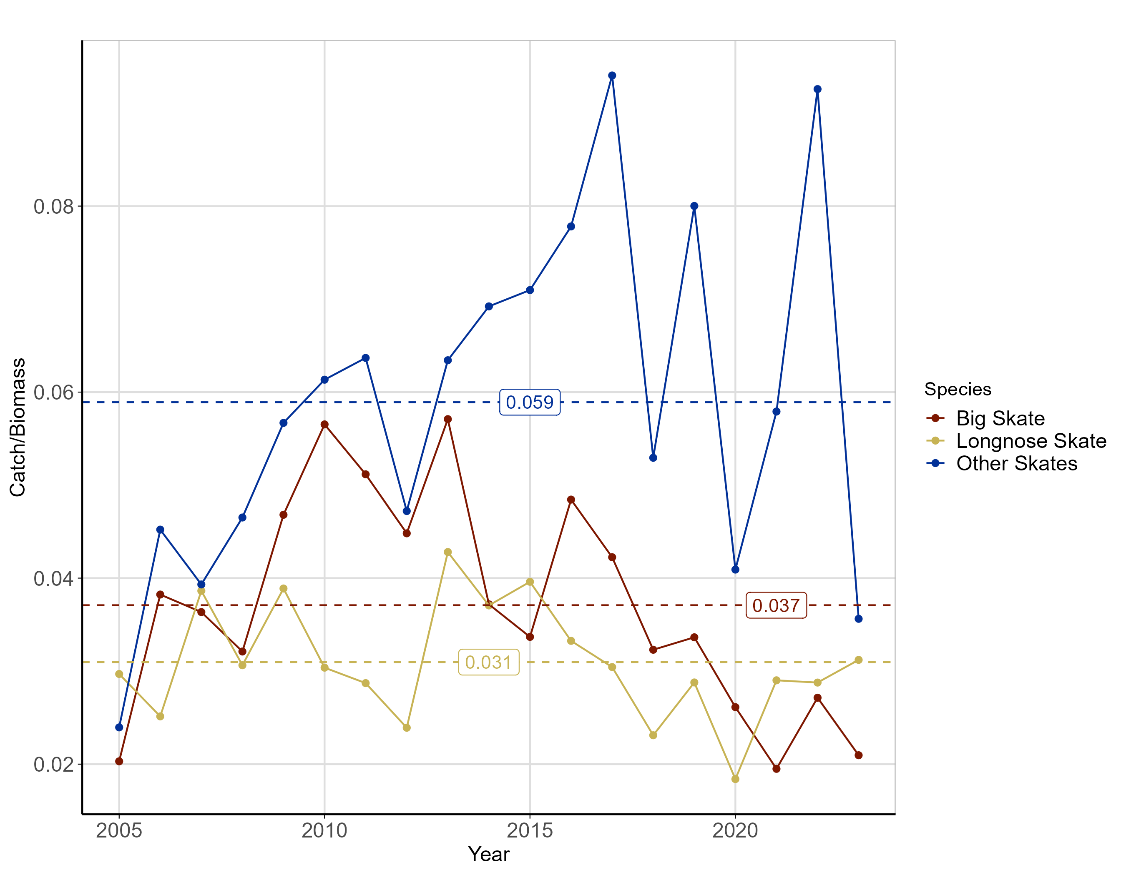
Gulf-wide Exploitation Rate (Catch/Biomass)
Notes:
Big Skate mean - 0.037 / 2023 – 0.021
Longnose mean – 0.031 / 2023 – 0.031
Other Skate mean – 0.059 / 2023 – 0.036

Slide 20
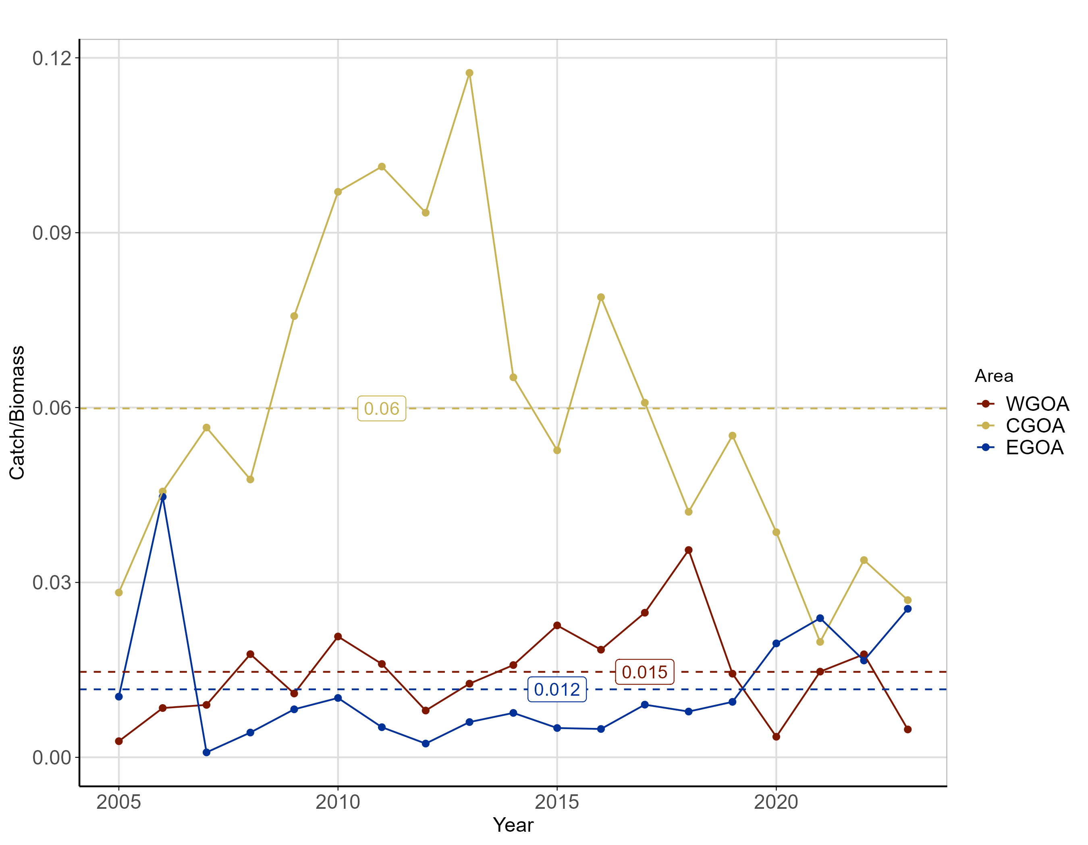
Big Skate Area Exploitation Rate (Catch/Biomass)
Notes:
WGOA mean – 0.015 / 2023 – 0.005
CGOA mean – 0.060 / 2023 – 0.027
EGOA mean – 0.012 / 2023 – 0.025

Slide 21
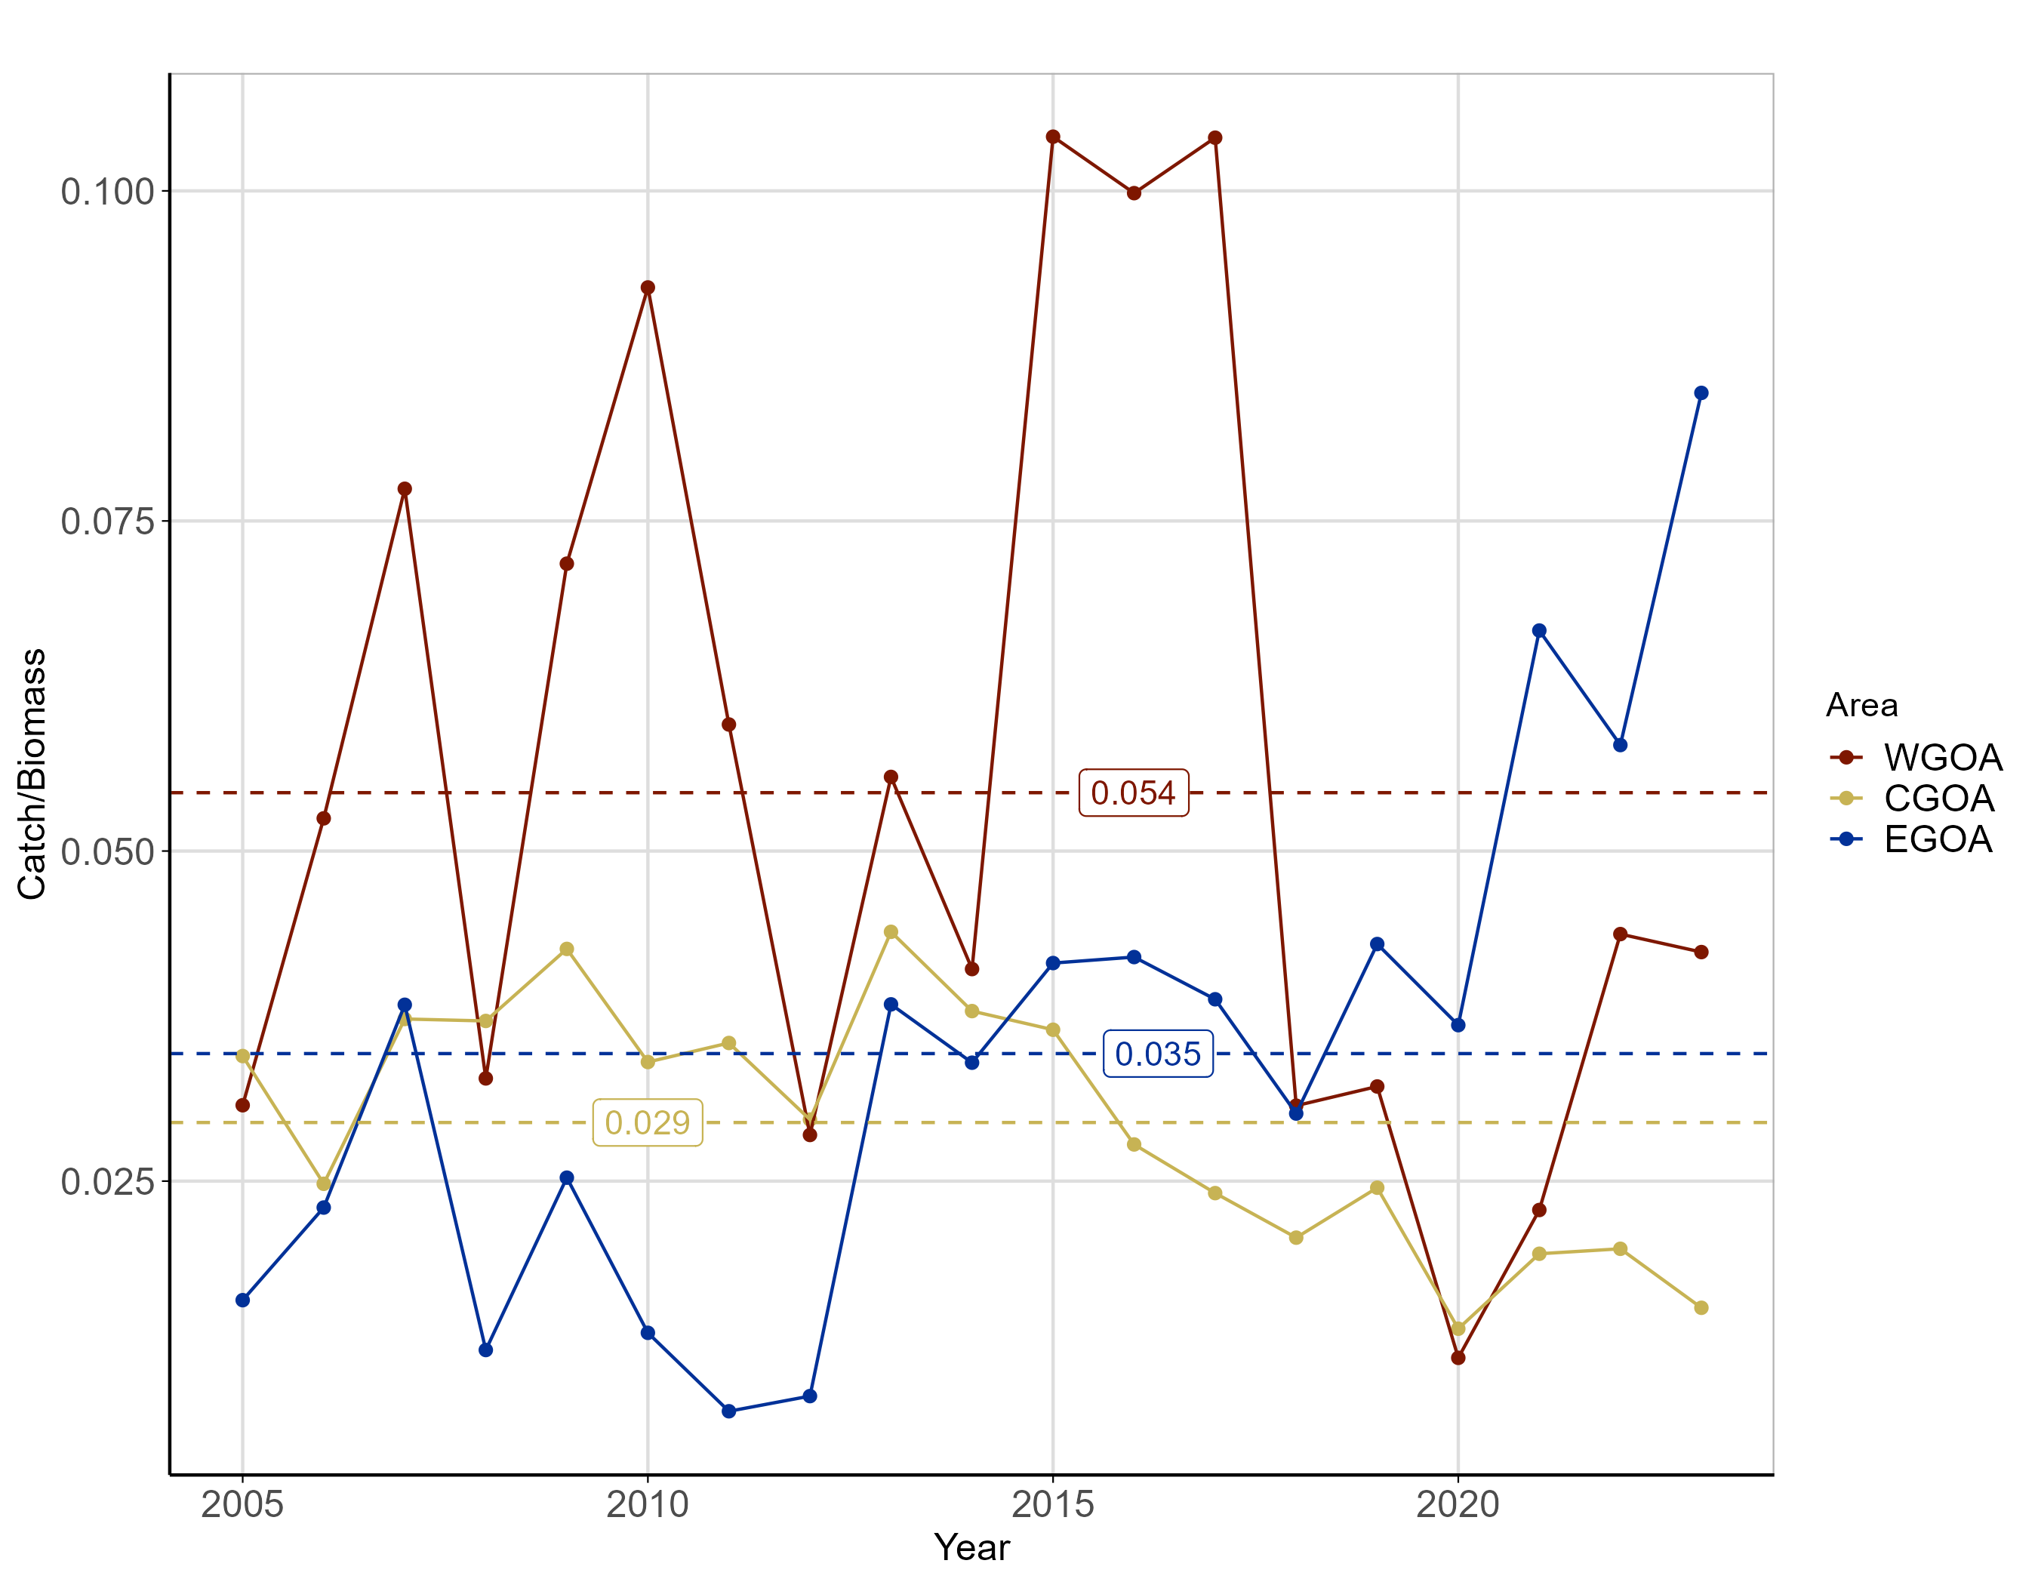
Longnose Skate Area Exploitation Rate (Catch/Biomass)
Notes:
WGOA mean – 0.015 / 2023 – 0.042
CGOA mean – 0.029 / 2023 – 0.015
EGOA mean – 0.035 / 2023 – 0.085

Slide 22
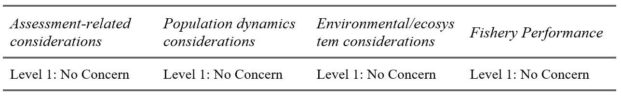
Risk Table Summary

Slide 23
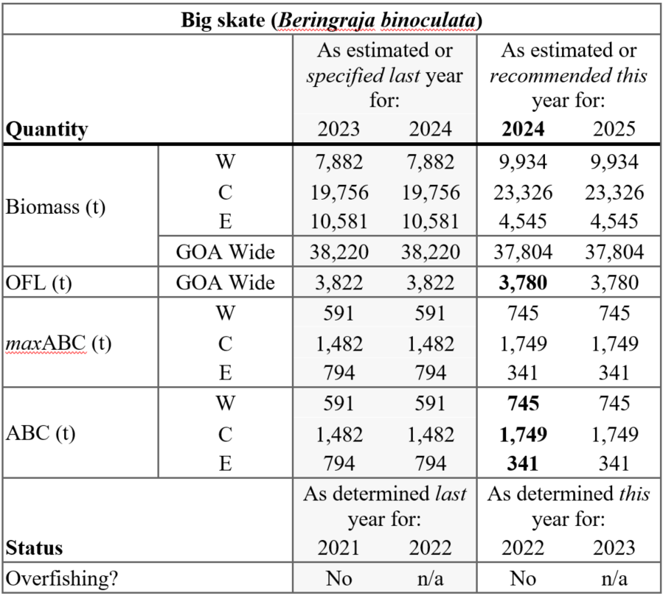
Big Skate Harvest Recommendations
Tier 5
M = 0.1
FOFL = M = 0.1
maxFABC = 0.75*M = 0.075
FABC = 0.75*M = 0.075

Slide 24
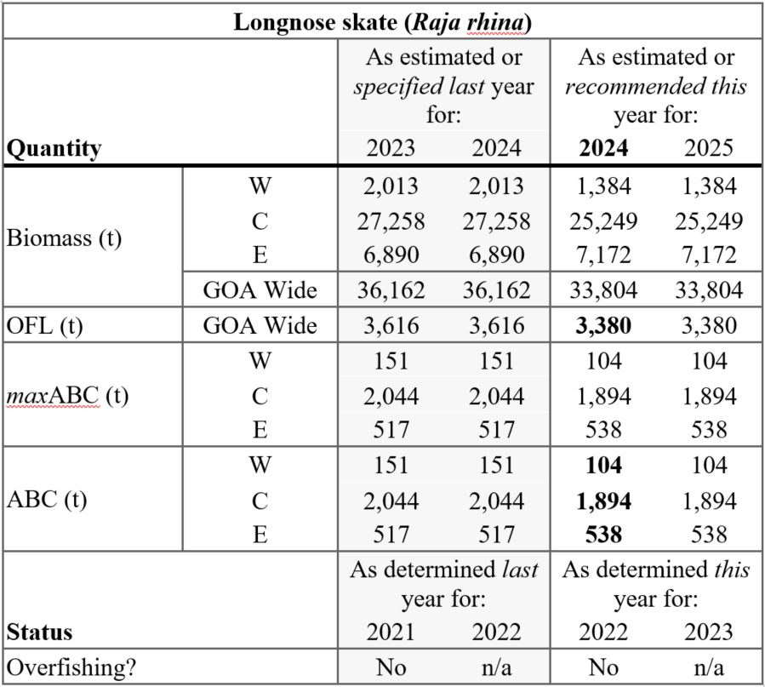
Longnose Skate Harvest Recommendations
Tier 5
M = 0.1
FOFL = M = 0.1
maxFABC = 0.75*M = 0.075
FABC = 0.75*M = 0.075

Slide 25
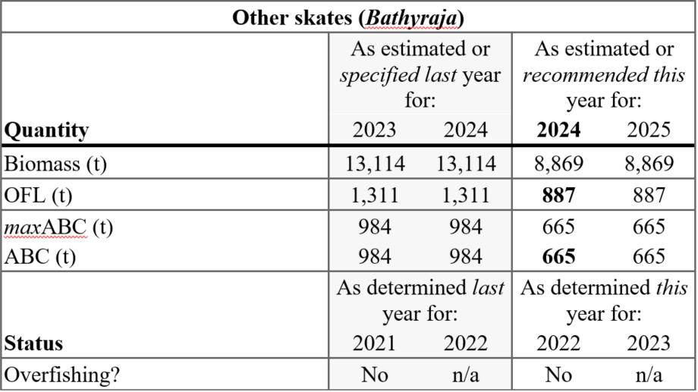
Other Skate Harvest Recommendations
Tier 5
M = 0.1
FOFL = M = 0.1
maxFABC = 0.75*M = 0.075
FABC = 0.75*M = 0.075

Slide 26
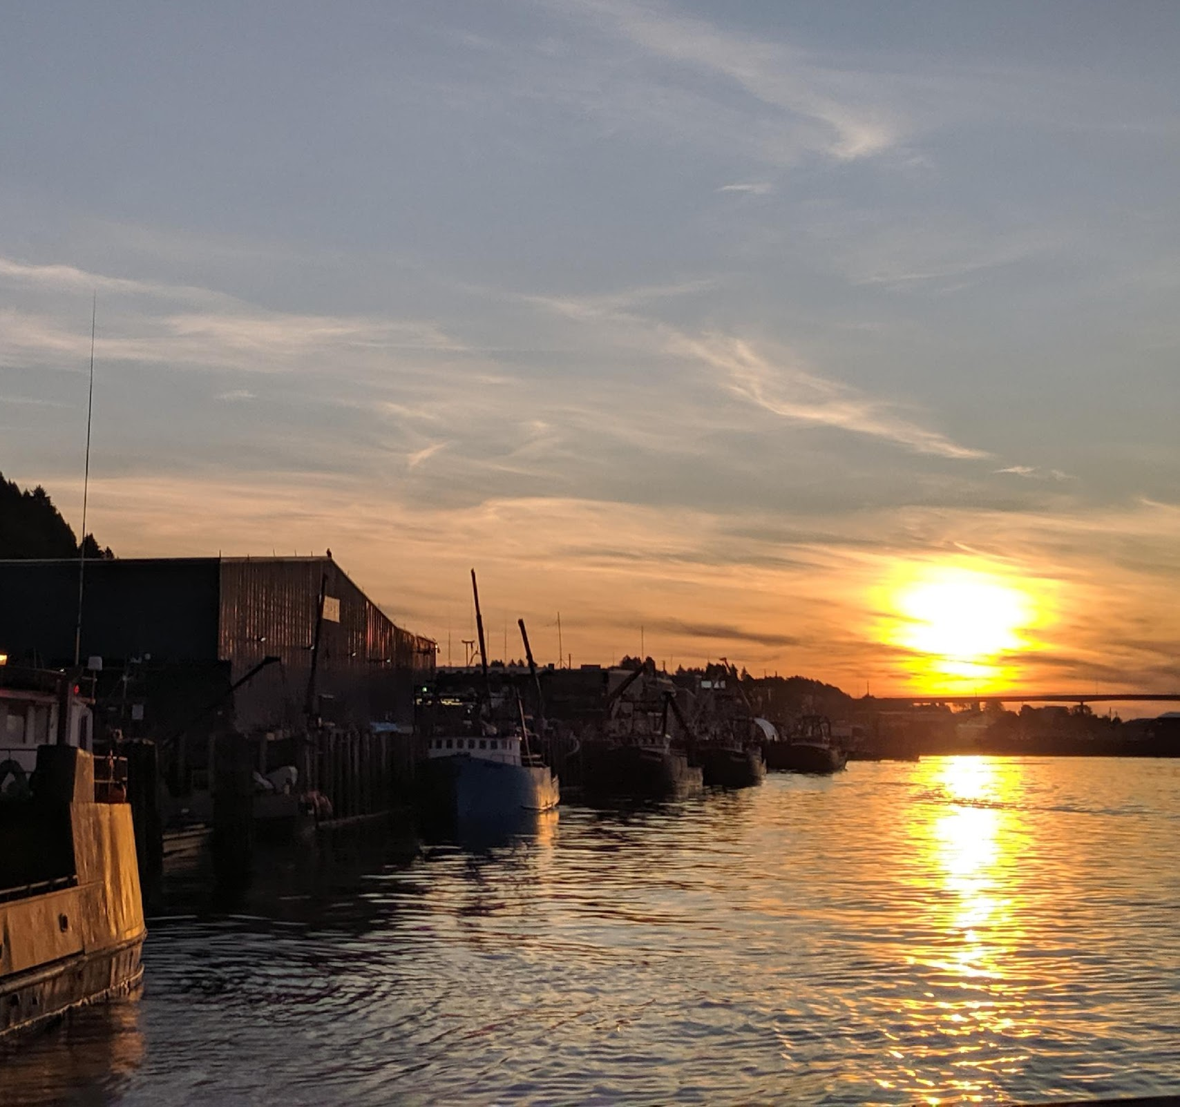
QUESTIONS?
Contact:
LEE.CRONIN-FINE@NOAA.GOV

Slide 27
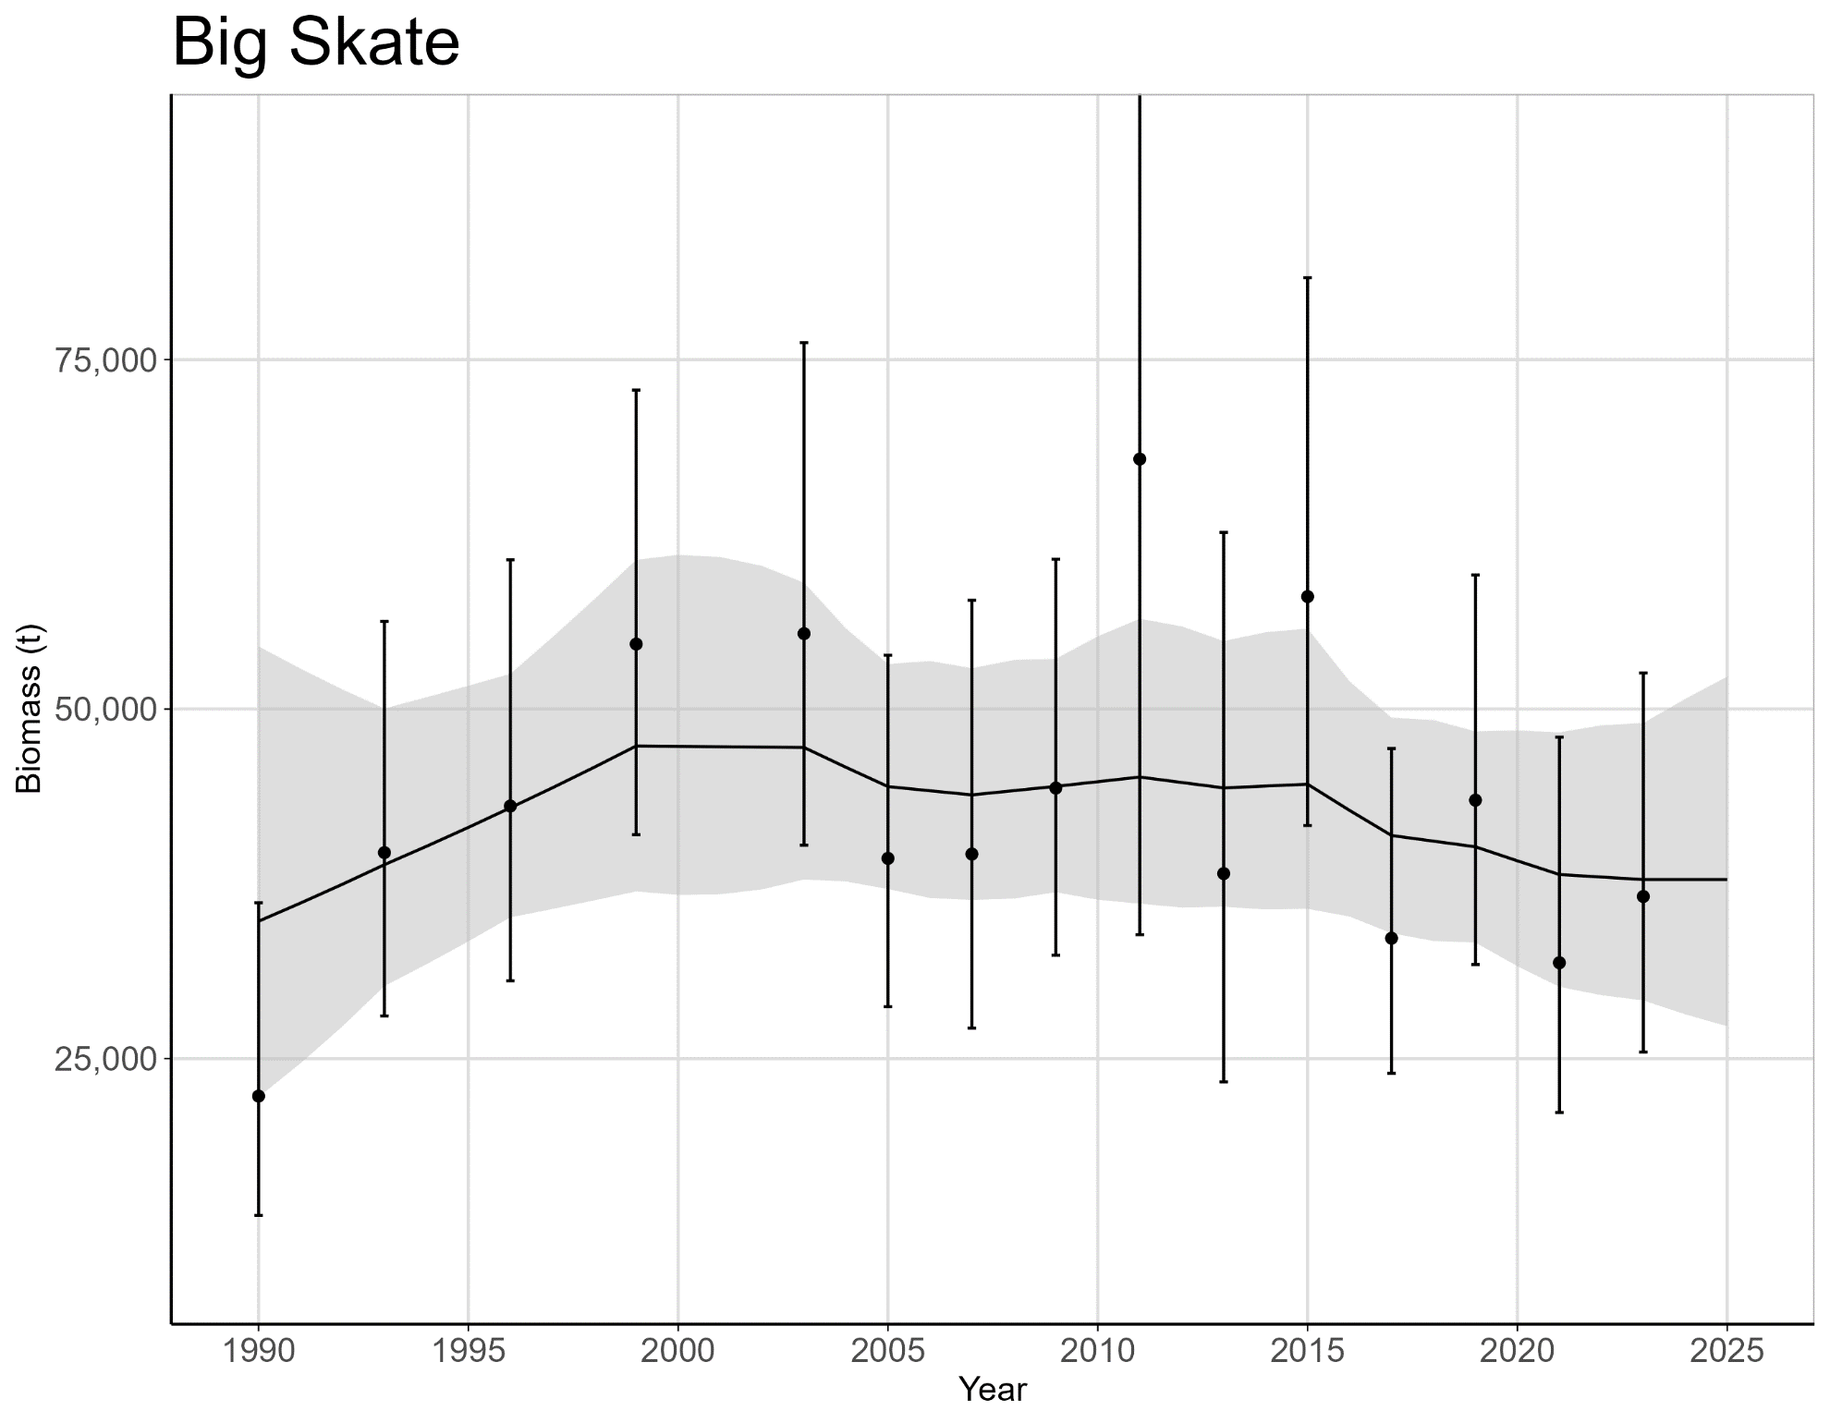
Gulf-wide Big Skate RE model

